Slide 1
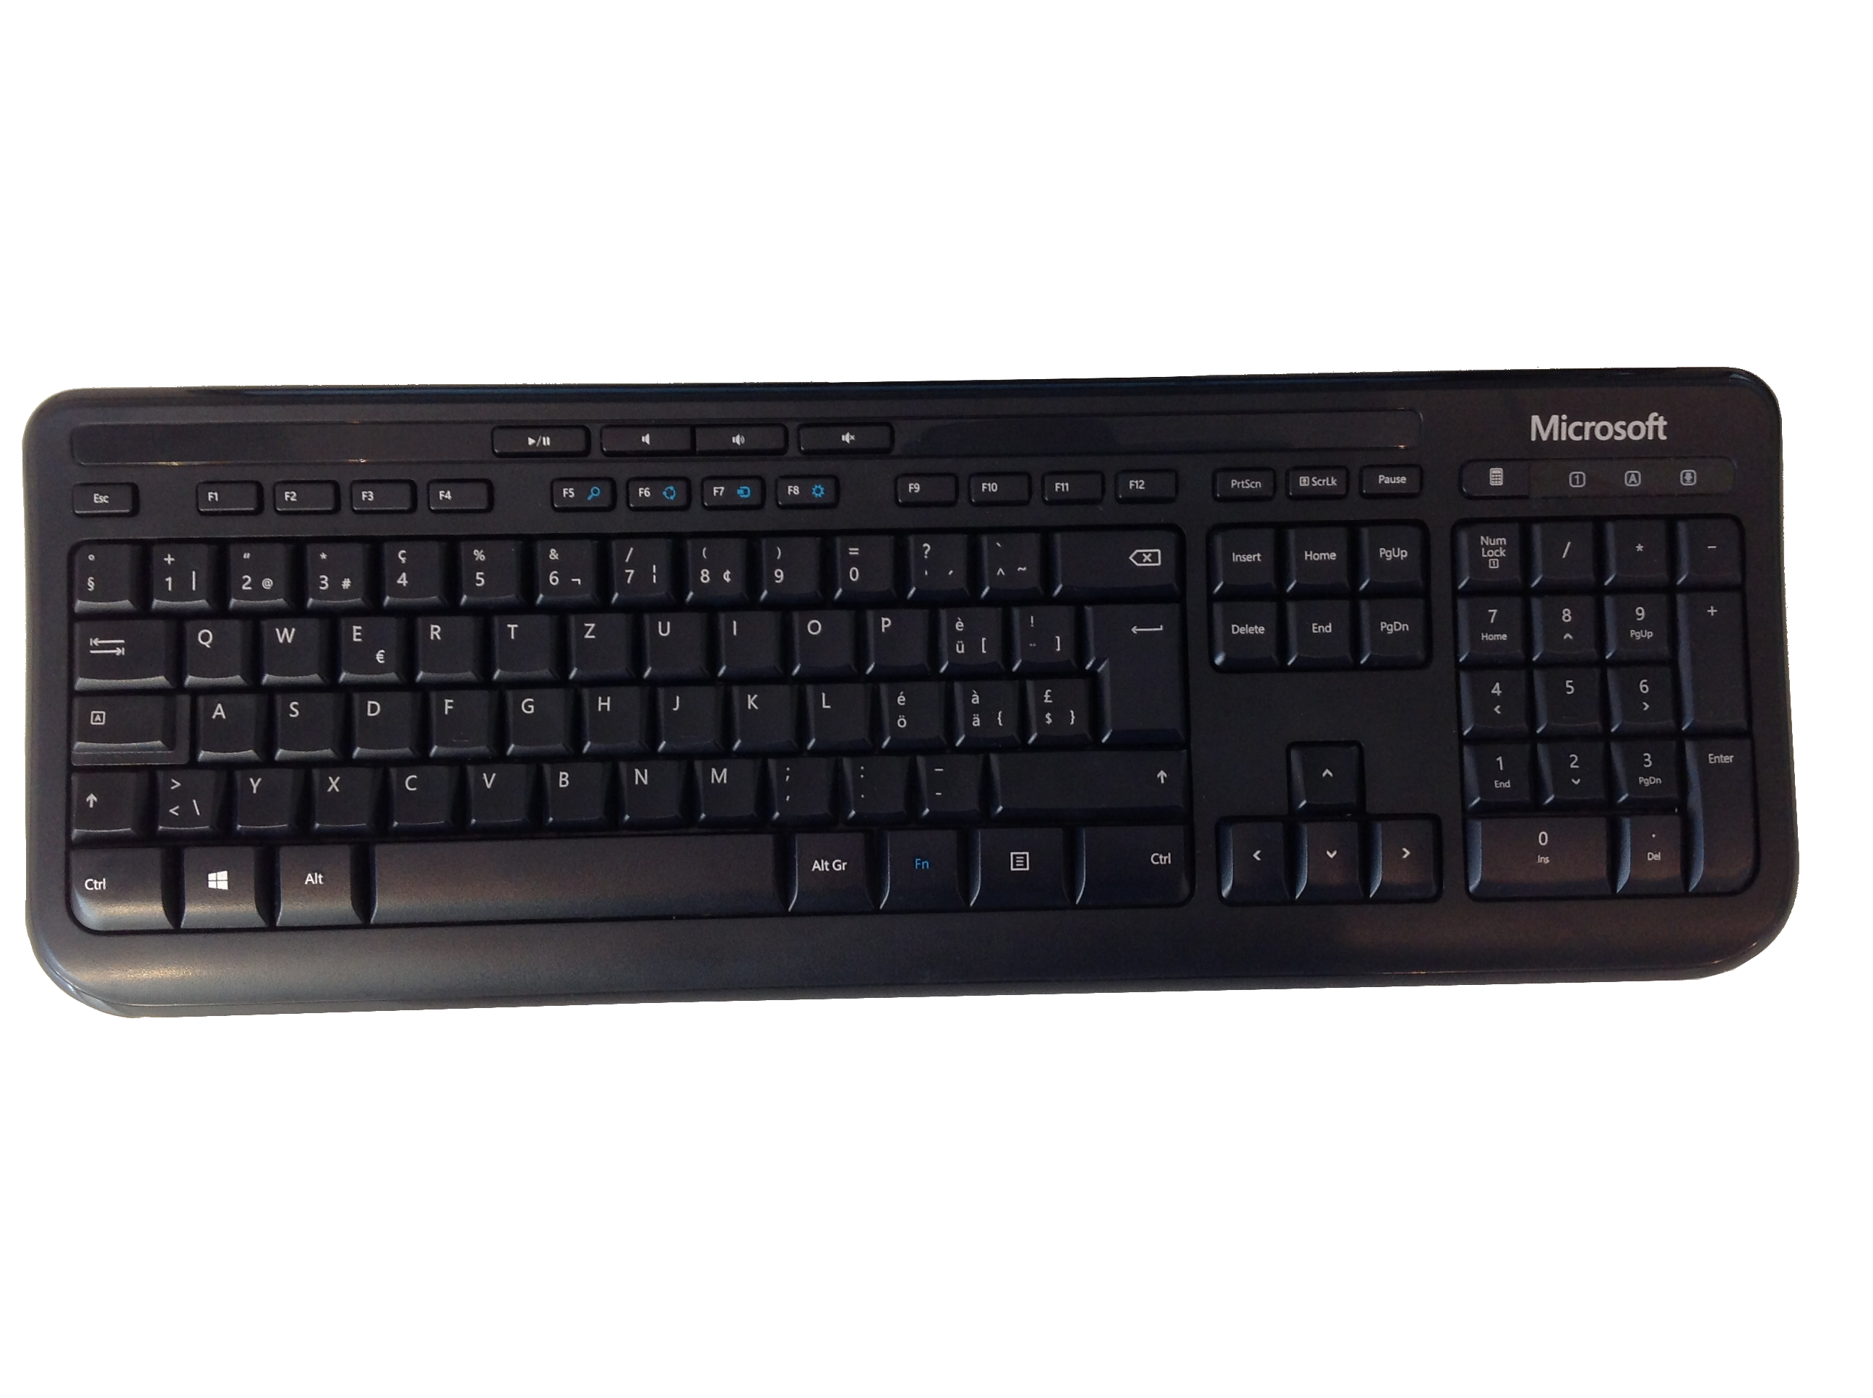
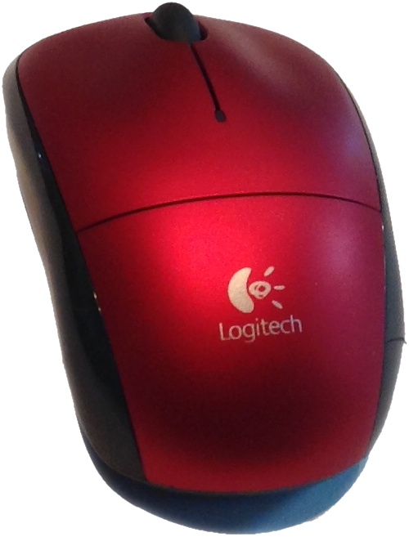


Rationalizing Recommender Systems
+
?
A wireless mouse which works well.
A red mouse from Logitech.
This mouse is too expensive!
Michael Bühler
Master’s Thesis, 2017
Notes:
https://www.amazon.com/AmazonBasics-KU-0833-Wired-Keyboard/dp/B005EOWBHC/ref=sr_1_3?s=electronics&ie=UTF8&qid=1512651879&sr=1-3&keywords=keyboard

Slide 2








I am very happy with this mouse. The mouse is small and works well.
A trendy, affordable mouse from Logitech. Recommended!
S1, S2, S3, S4, S5, ...

Slide 3
/
Context Product
Algorithm
S1, S4
S1, S2, S3, S4
Target Product

Slide 4
Context Product
/
S1, S4
Sampling
Predicting
S1, S2, S3, S4
Target Product

Slide 5
Context Product
/
S1, S4
Sampling
Predicting
S1, S2, S3, S4
Target Product

Slide 6
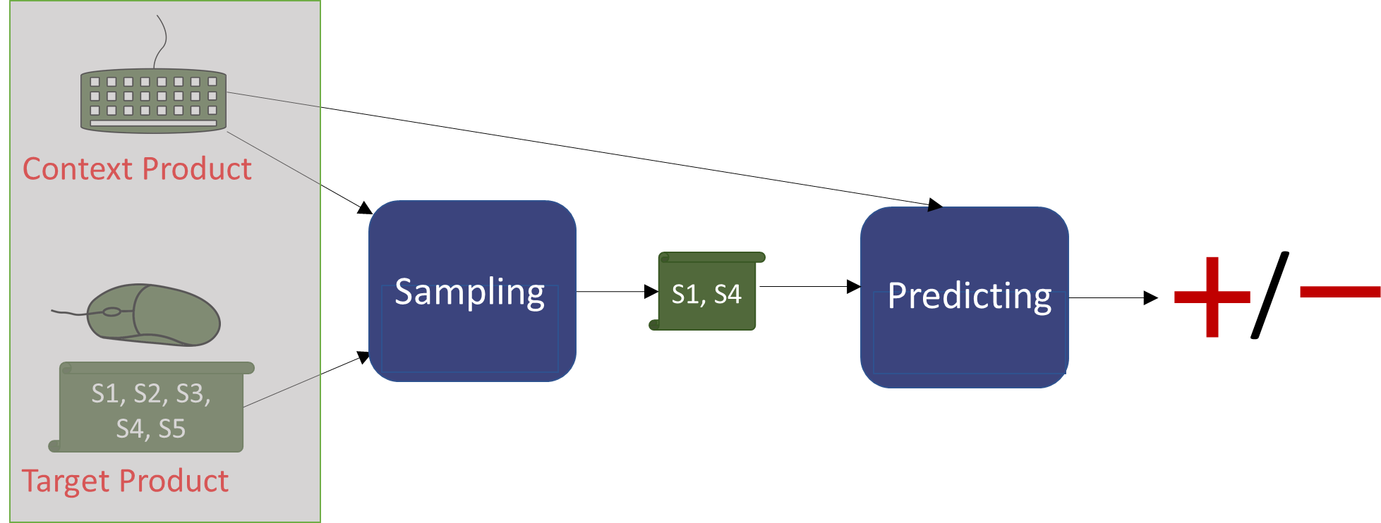


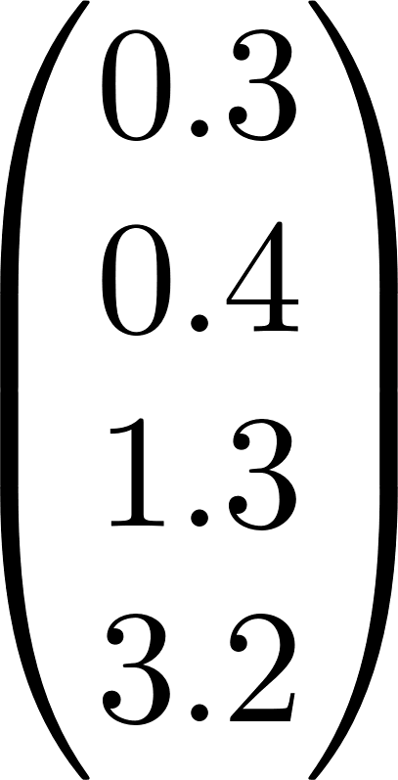
FLIC
similar
not similar

Slide 7

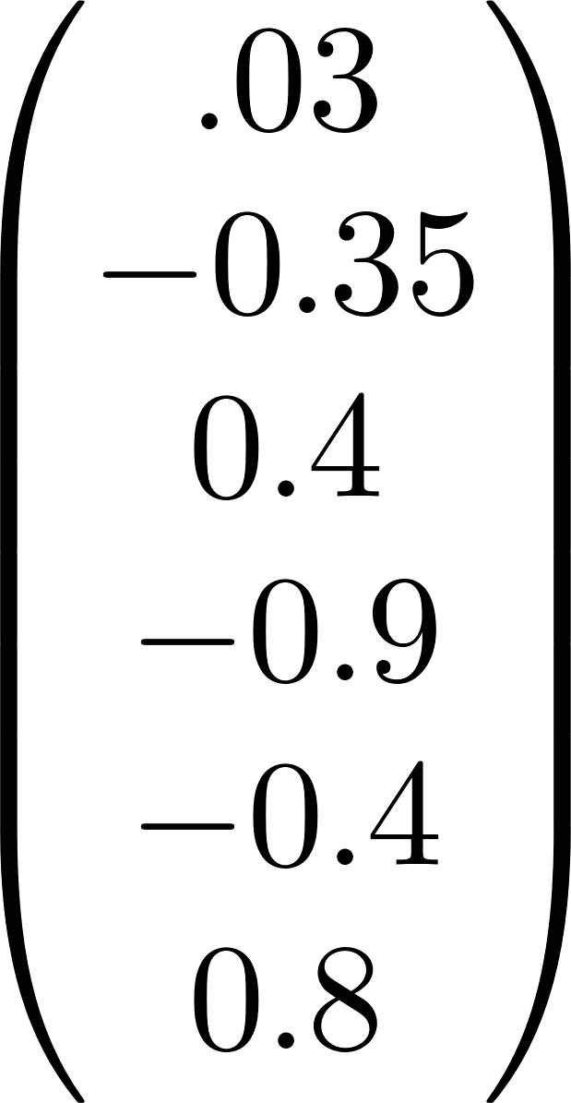

Context Product
FLIC
Feed Forward Layer
context vector

Slide 8
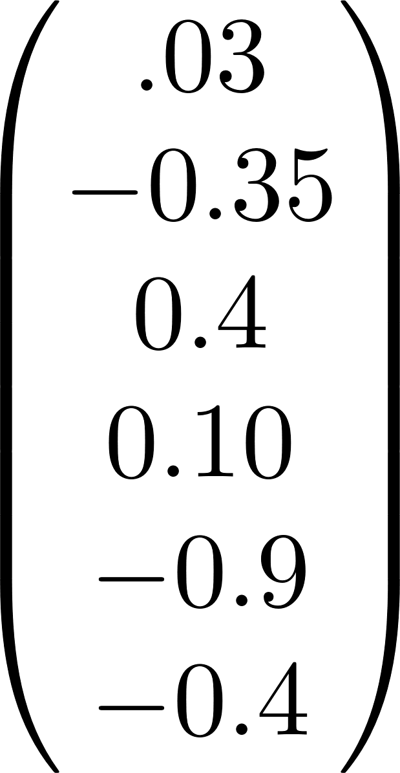
Target Product
S1, S2, S3, S4
A great mouse!
Sentence Embedding Model

Slide 9

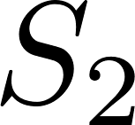
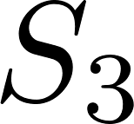

Target Product
S1
Sentence Embedding Model
S2
Sentence Embedding Model
S3
Sentence Embedding Model
S4
Sentence Embedding Model

Slide 10
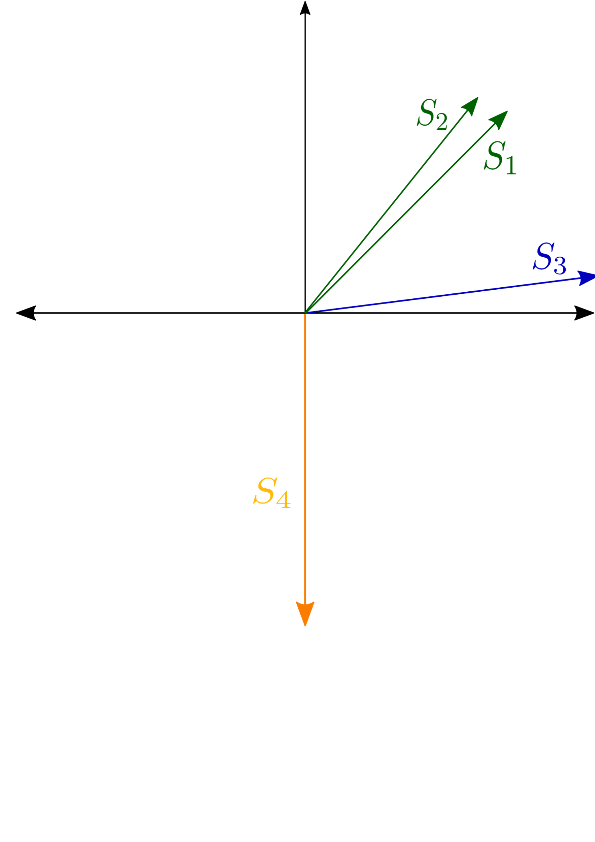
Target Product
A trendy green computer mouse.
A fashionable olive-green mouse.
This mouse has a lot of buttons.
Cats like to play with this mouse.

Slide 11

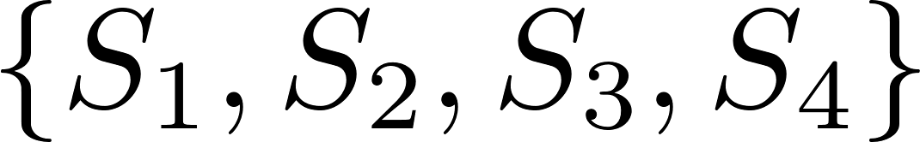
Context Product
S1, S2, S3, S4
Target Product

Slide 12
Context Product
/
S1, S4
Sampling
Predicting
S1, S2, S3, S4
Target Product

Slide 13
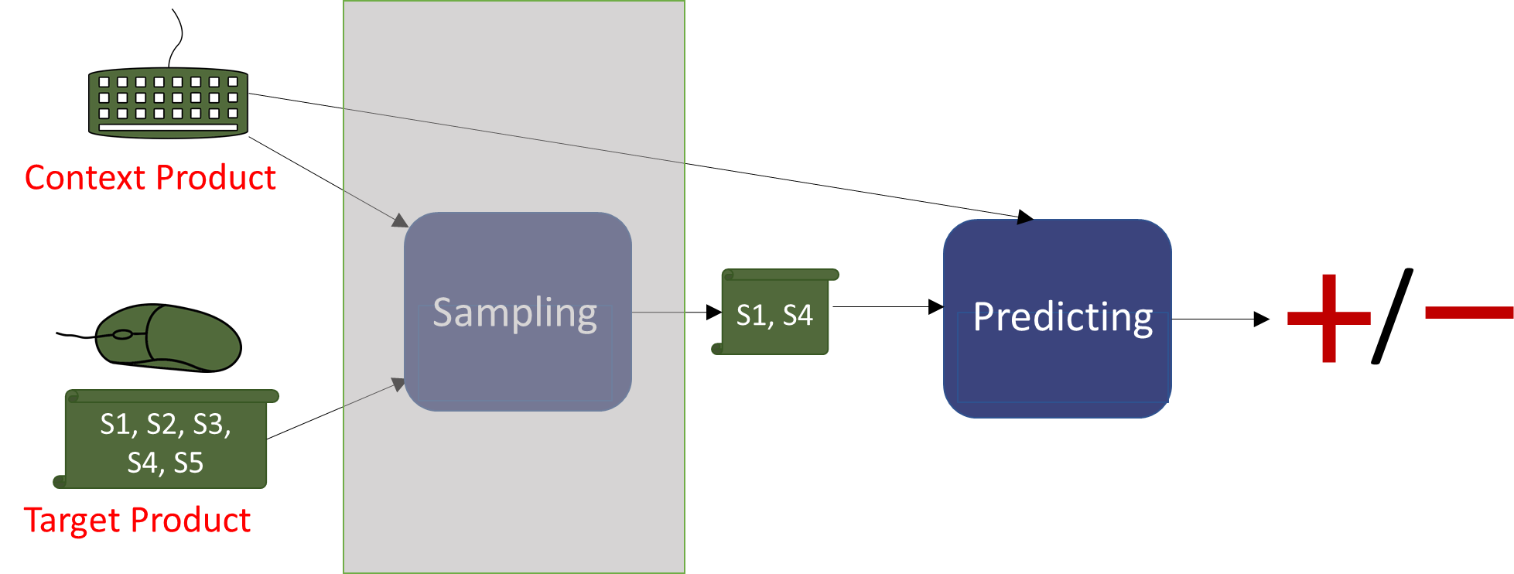
Sampling (DPP)
A trendy green computer mouse.
A fashionable olive-green mouse.
This mouse has a lot of buttons.
Cats like to play with this mouse.
DPP
1) context dependent
2) diverse sentences

Slide 14
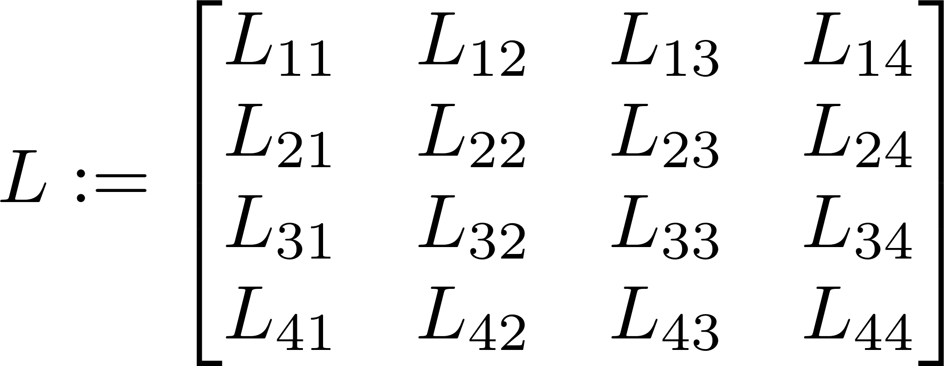
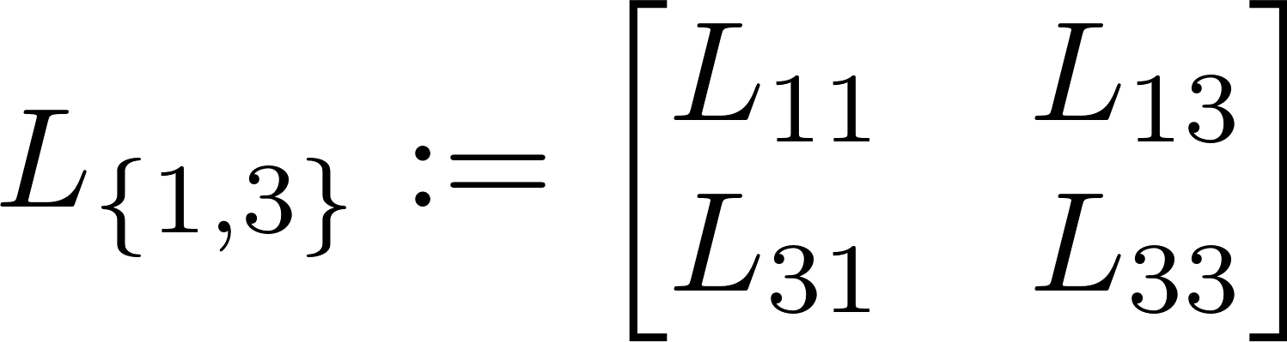
L-Ensemble (DPP)
A trendy green computer mouse.
A fashionable olive-green mouse.
This mouse has a lot of buttons.
Cats like to play with this mouse.

Slide 15
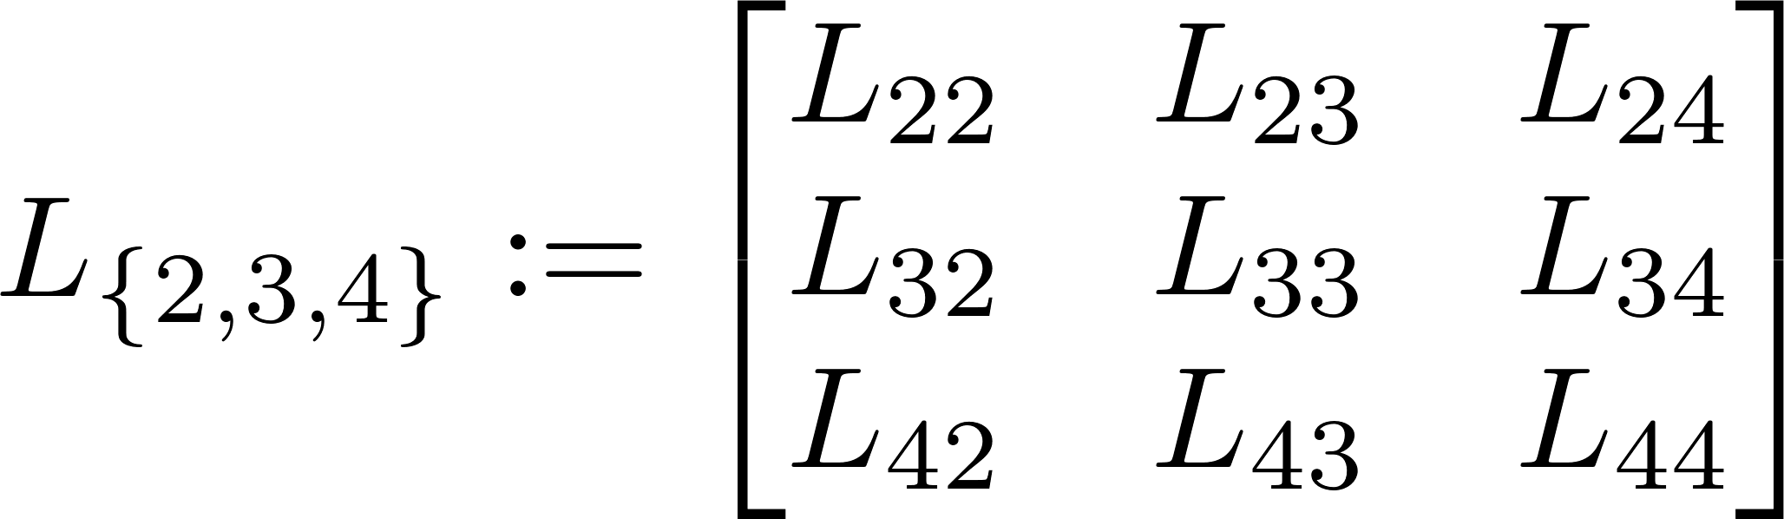
L-Ensemble (DPP)
A trendy green computer mouse.
A fashionable olive-green mouse.
This mouse has a lot of buttons.
Cats like to play with this mouse.

Slide 16

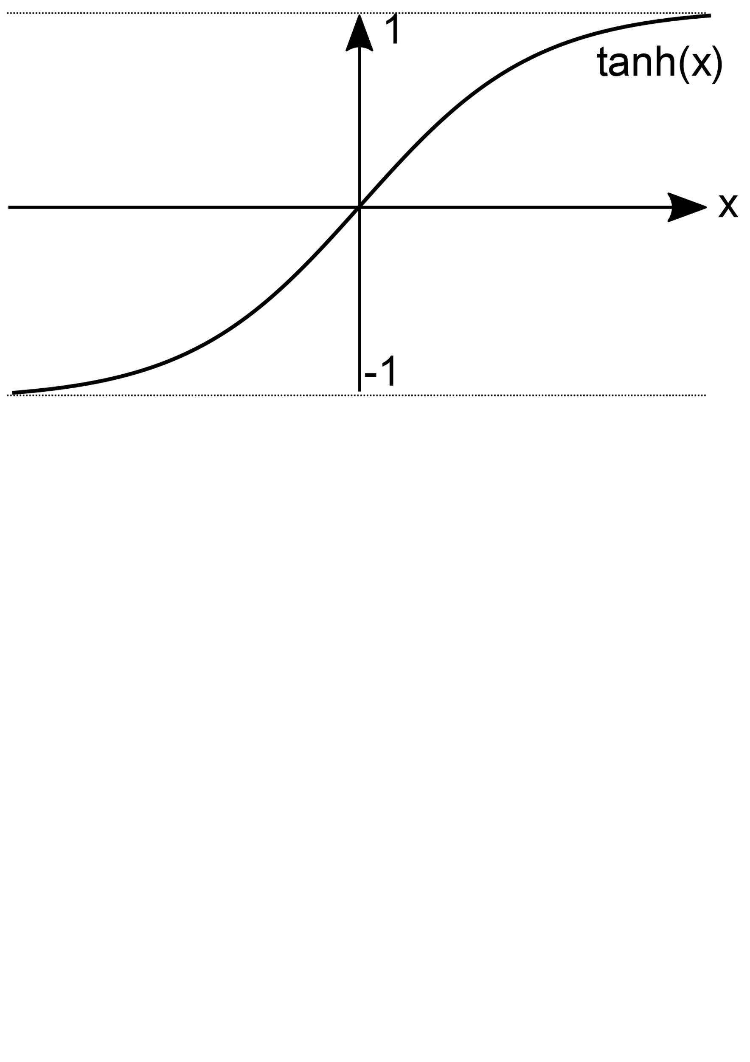
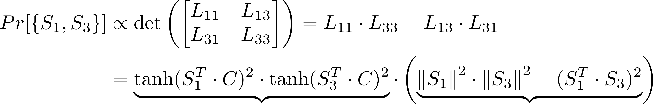
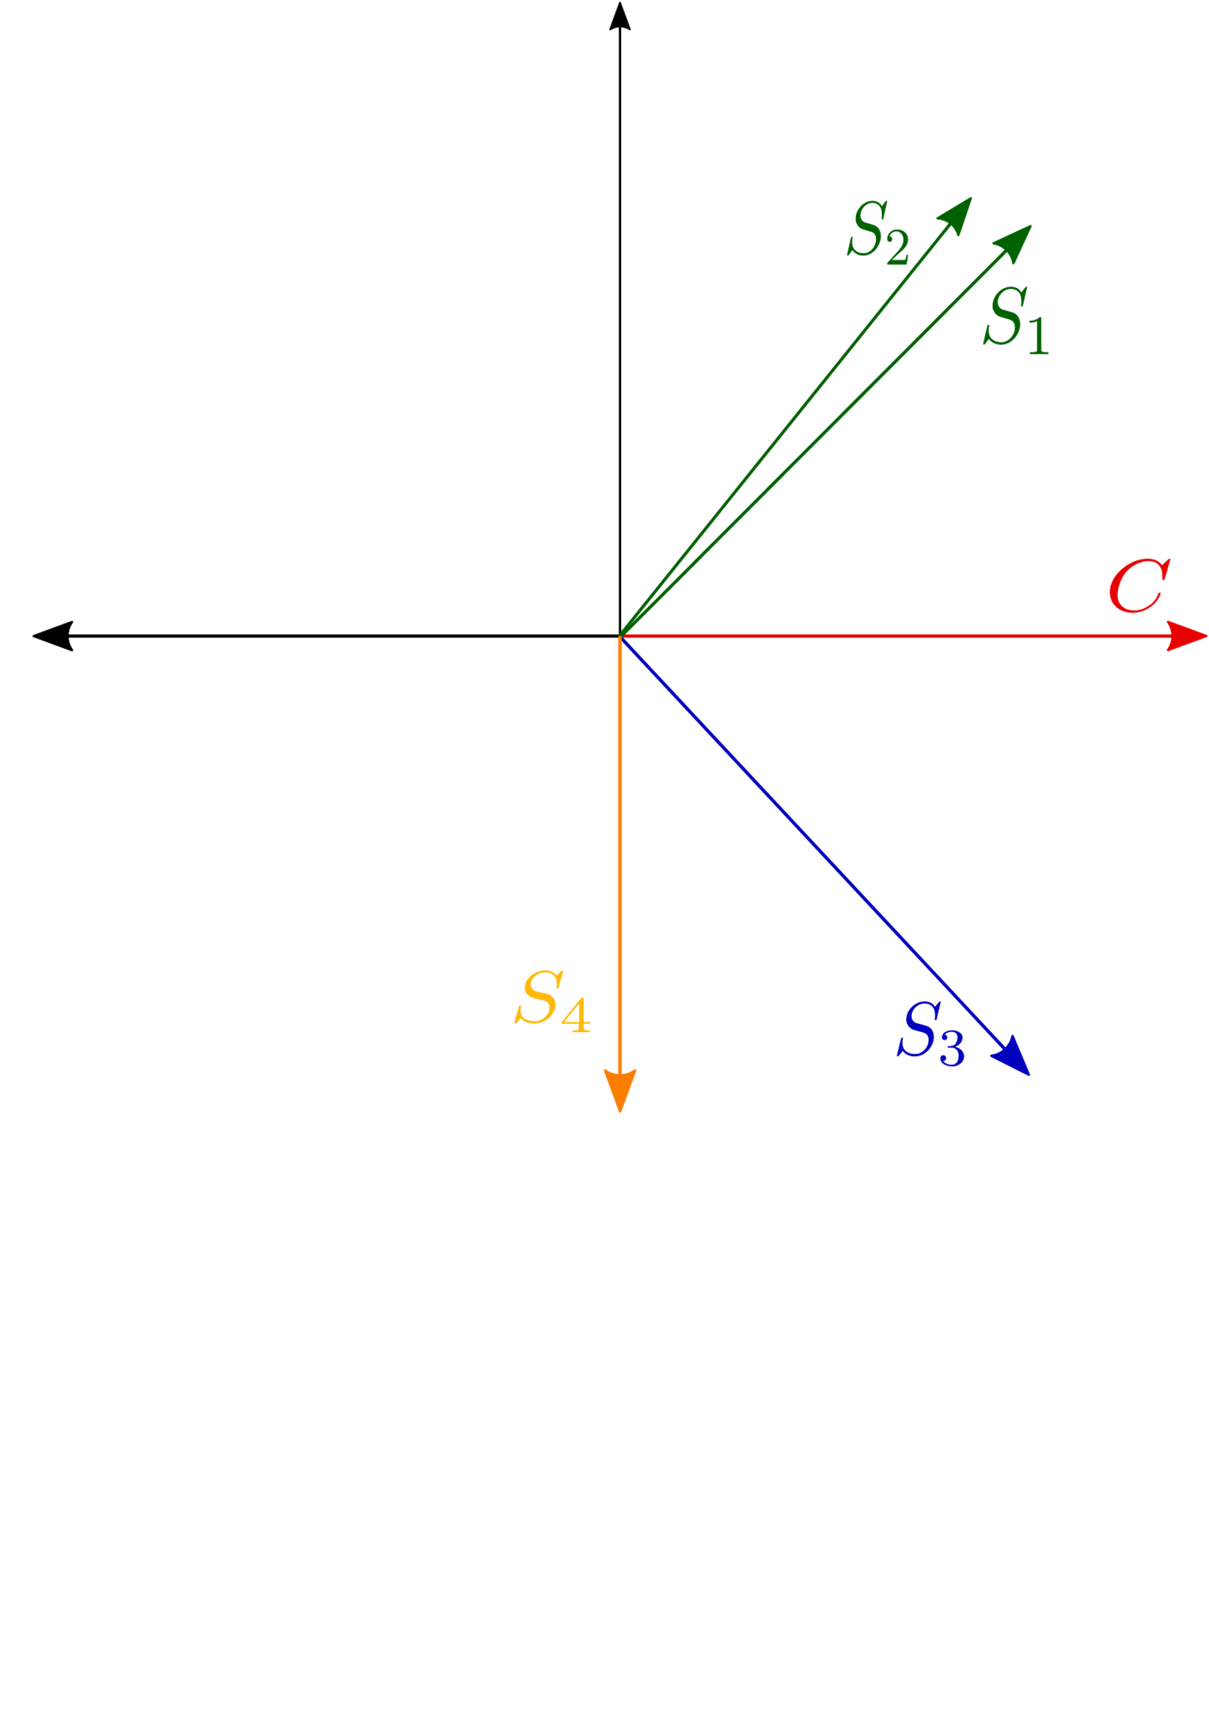
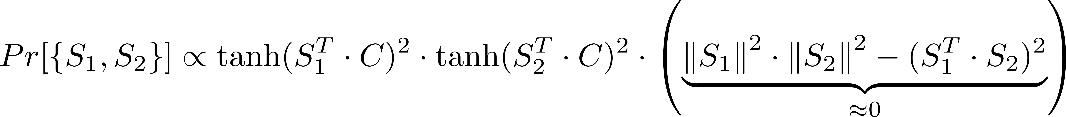
Definition of
context dependency
diversity

Slide 17
Sampling (DPP)
A trendy green computer mouse.
A fashionable olive-green mouse.
This mouse has a lot of buttons.
Cats like to play with this mouse.
DPP
1) context dependent
2) diverse sentences
3) efficient sampling is possible

Slide 18
Context Product
/
S1, S4
Sampling
Predicting
S1, S2, S3, S4, S5
Target Product

Slide 19
Data Sets
,
Link
Context Product
Target Product

Slide 20



,
,
,
,
,
,
,
,

Slide 21
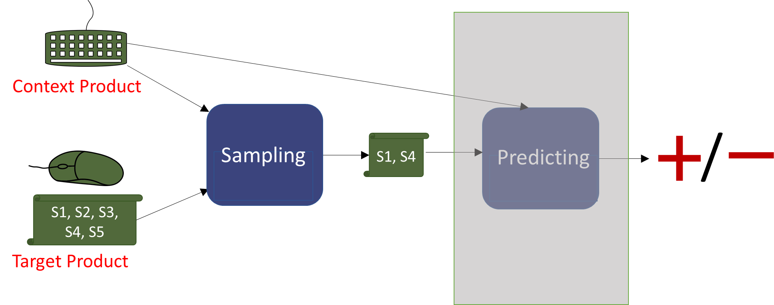
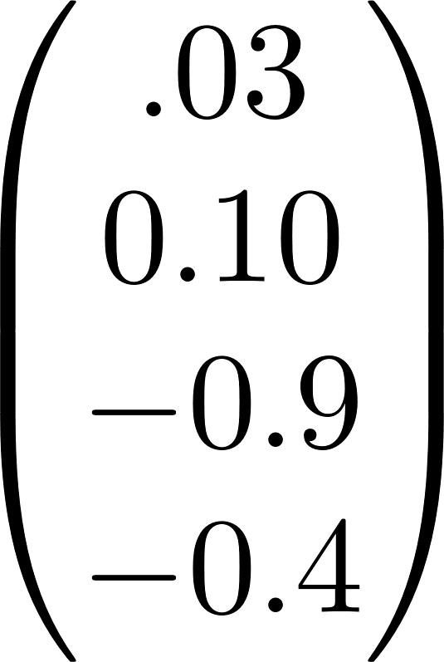
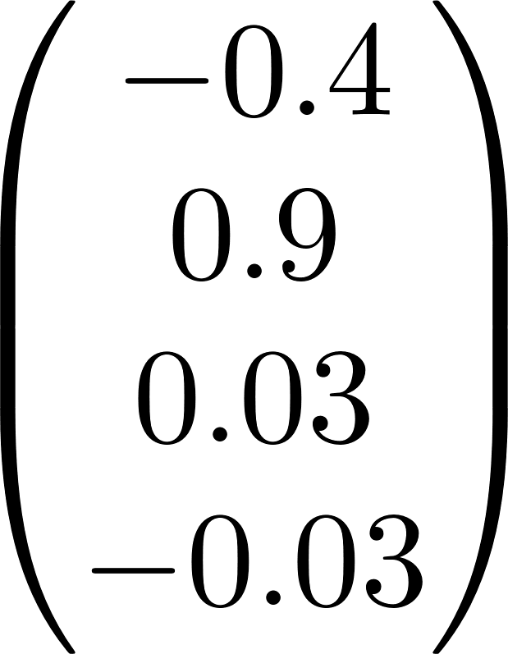
Deep Sets
RNN
Deep Sets
RNN
Deep Sets

Slide 22


Predicting
,
S1, S3
Deep Sets
Logistic
Regression

Slide 23
Context Product
/
S1, S4
Sampling
(DPP)
Predicting
S1, S2, S3, S4, S5
Target Product

Slide 24
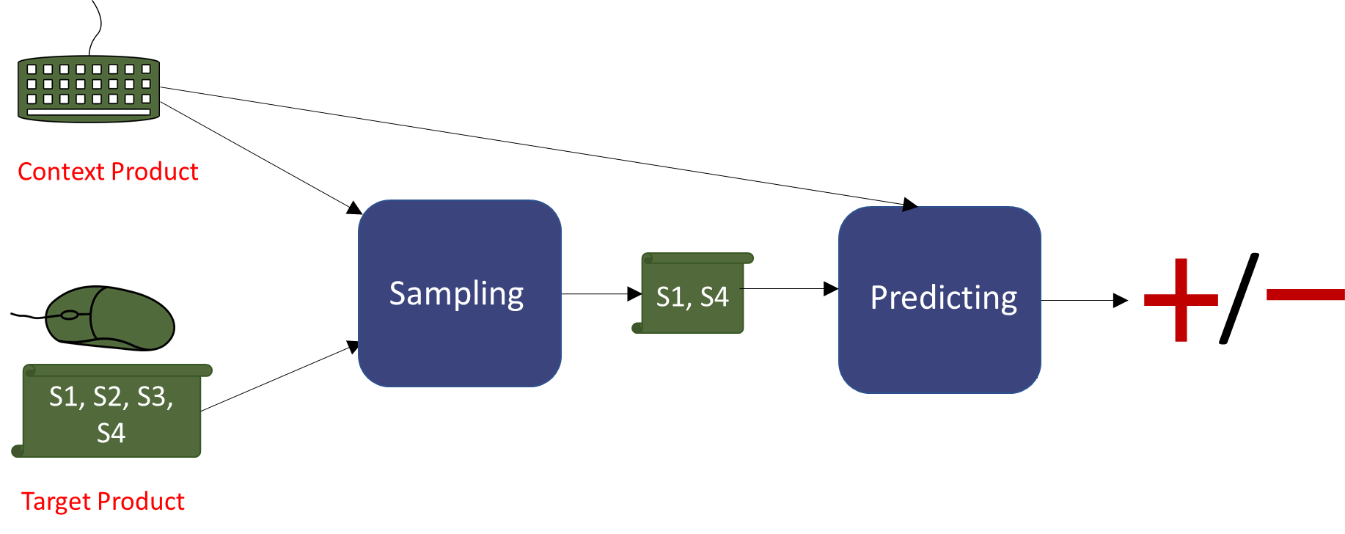
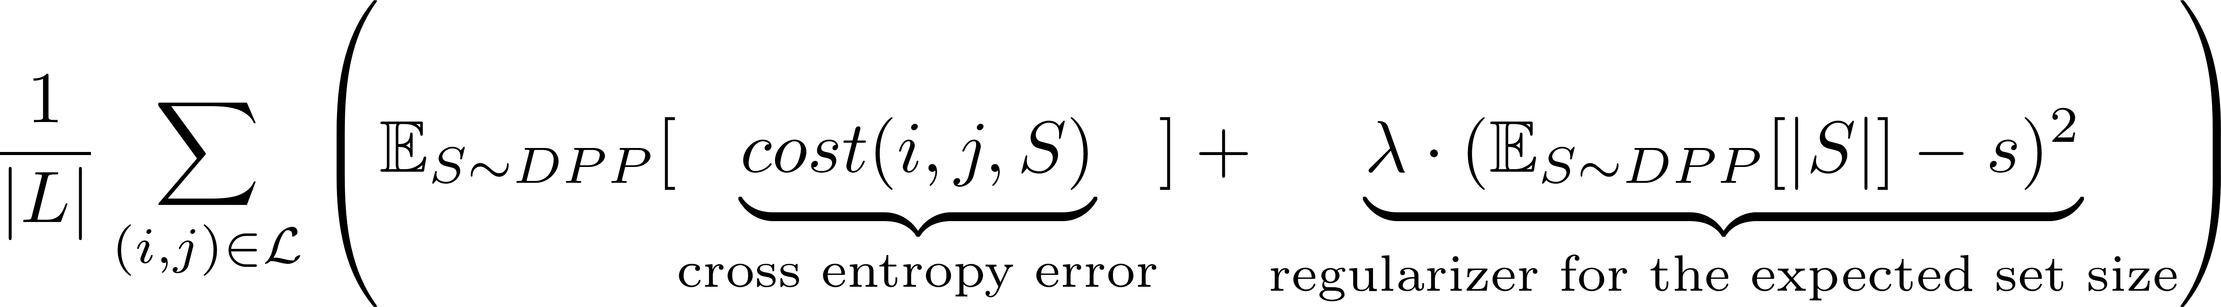
Cost Function

Slide 25
Cost Function

Slide 26
Cost Function

Slide 27
Cost Function

Slide 28
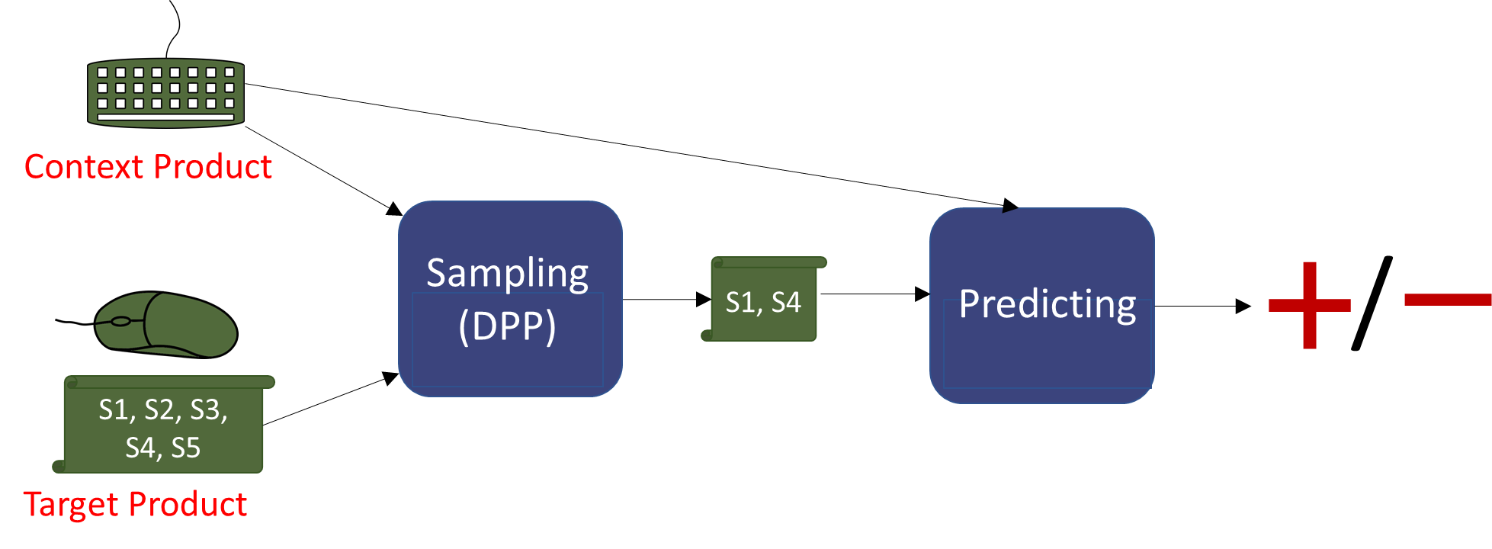
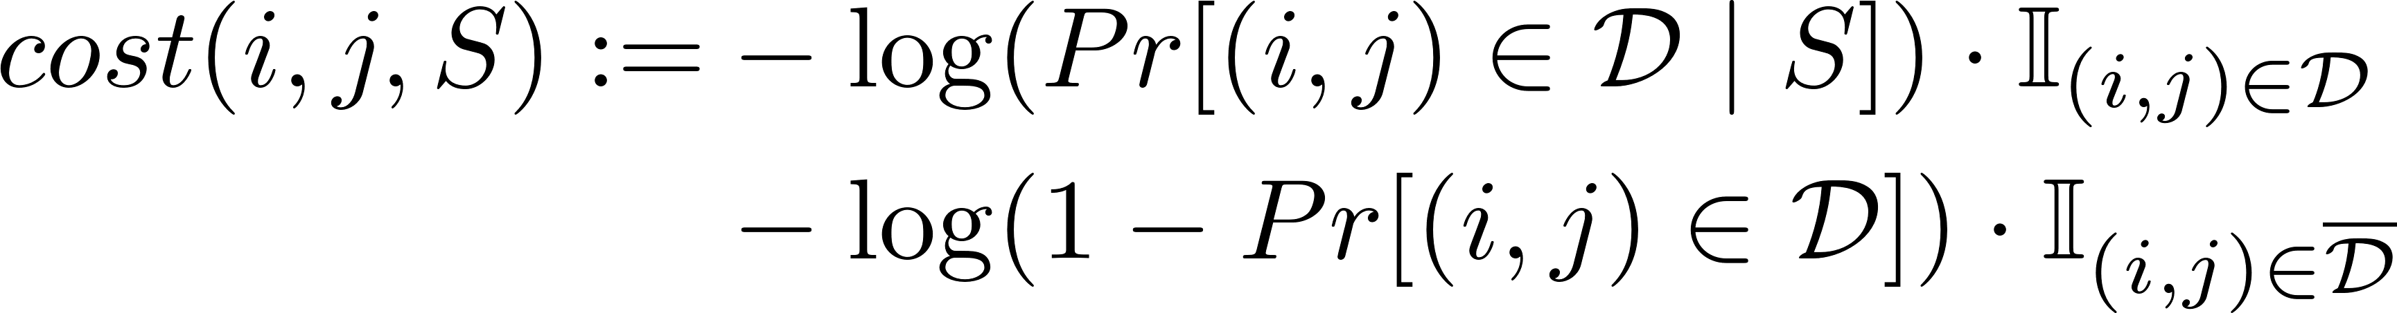
Cost Function

Slide 29
Context Product
/
S1, S4
Sampling
Predicting
S1, S2, S3, S4
Target Product

Slide 30
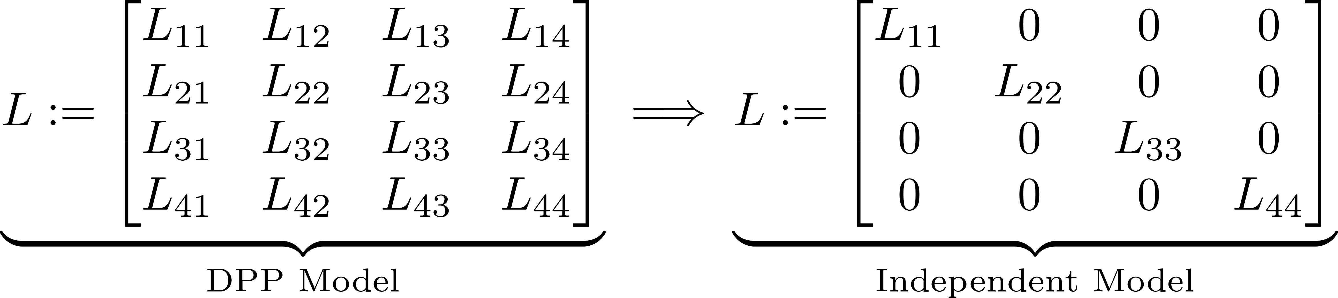
Baselines
1) Independent Model
1) context dependent
2) diverse sentences

Slide 31
Baselines
2) Uniformly Sampled Sentences
A trendy green computer mouse.
A fashionable olive-green mouse.
This mouse has a lot of buttons.
Cats like to play with this mouse.
p
p
p
p

Slide 32




Baselines
3) Logistic Regression
FLIC
Logistic Regression
,
FLIC

Slide 33


Accuracy
Algorithm
,
,
,
,
,

Slide 34
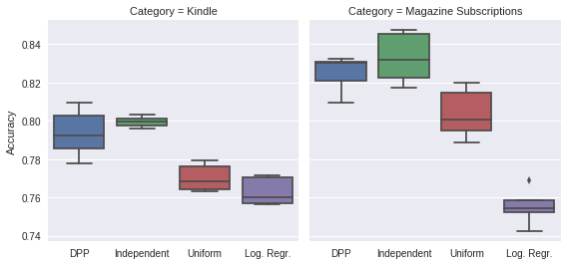
Comparison to Baselines

Slide 35
Quality of the Samples
,
Solitaire 2
Solitaire 1
1) Not as well designed as the EA Solitaire game for the Kindle keyboard, waiting for them to release a Paperwhite version.
2) I enjoyed the many choices on the menu for different types of Solitaire games.
3) The bonus is I am learning to play a variety of Solitaire games versus the one game I knew.
4) The reason I bought this suite was for the Klondike solitaire.
Solitaire
Notes:
https://www.amazon.com/dp/B009ZI12NM
https://www.amazon.com/dp/B006IZMWWA
https://www.amazon.com/dp/B00BORGGF6

Slide 36
Quality of the Samples
,
Game Book
Solitaire 1
1) In spite of its being in shades of gray, it's easy to differentiate between the red and black suits.
2) I enjoyed the many choices on the menu for different types of Solitaire games.
3) I didn't have any trouble distinguishing the black vs red.
4) (I didn't try it on any other type of Kindle so don't know how it does on them).
Notes:
https://www.amazon.com/dp/B009ZI12NM
https://www.amazon.com/dp/B006IZMWWA
https://www.amazon.com/dp/B00BORGGF6

Slide 37
GitHub: https://github.com/buehlmic/MThesis_Rationalizing_Recommender_Systems
Email: buehler_michael@bluewin.ch

Slide 38
Constructing
,
,
,
,
,
,

Slide 39
FLIC
similar
not similar

Slide 40
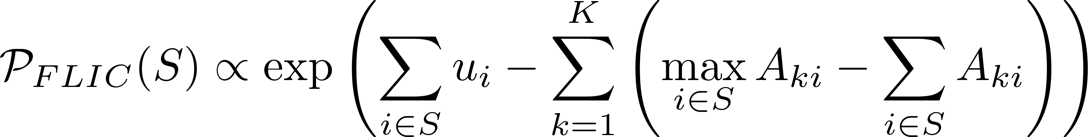
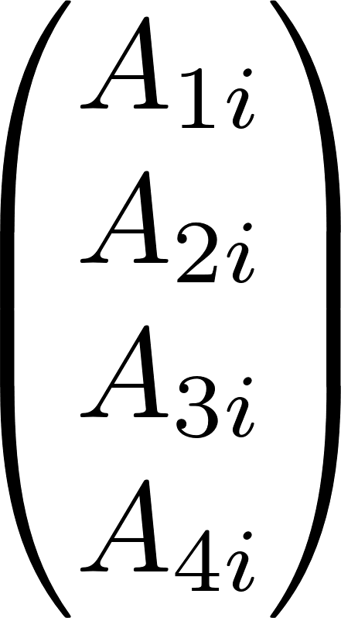
FLIC
topic vector

Slide 41
FLIC Training Set

Slide 42
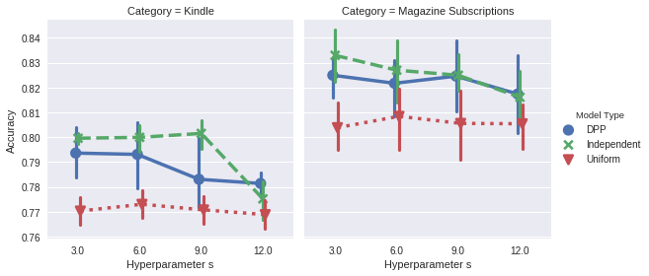
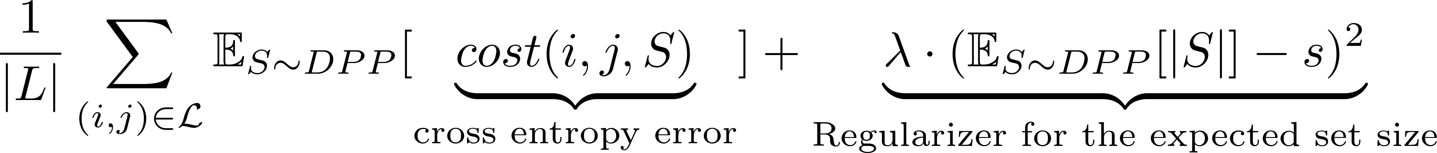
Number of Sampled Sentences

Slide 43
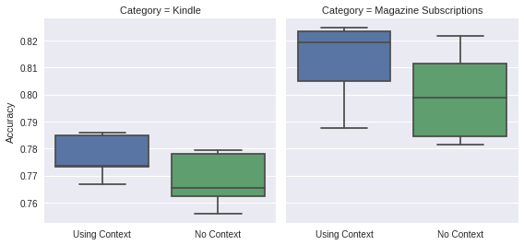
With and Without Context

Slide 44
,
,
,
,
,
,
,
,
training set
test set

Slide 45
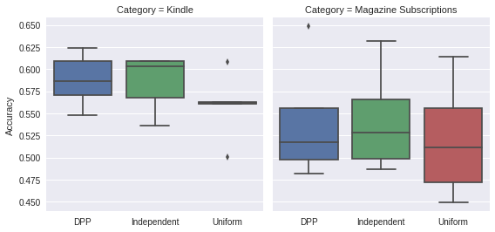
New Test Sets

Slide 46
Comparison to Baselines

Slide 47
Number of Sampled Sentences

Slide 48
With and Without Context

Slide 49
Test Set

